Slide 1


Fighting Impostor Syndrome
A Practical Handbook
17:05 PM – 17:40 PM
17 November 2022 // SymfonyCon 2022
Notes:
I can see your future and it’s really great

Slide 2

Horoscope for the next 35 minutes

Slide 3

Horoscope for the next 35 minutes
Let’s get acquainted!
A little bit of history
Ok but… What is it?
The practical bit (finally)
“Not a question, more of a comment”
Sources???

Slide 4
1. Let’s get acquainted!
//
I promise, that’s kinda relevant

Slide 5


Marine Gandy
DevRel engineer at Platform.sh
That is me!

Slide 6

My journey
I come from a literary background
I switched to web development at 25
I’m the current President of the French Drupal Association
I’ve been working remotely for 3 years
I love and do many things outside of work!

Slide 7
So why am I talking about this?

Slide 8
how I feel at work
Because all these elements heavily influence

Slide 9
2. A little bit of history
//
“Your past is just a lesson, not a life sentence.” - Deep Life Quote

Slide 10

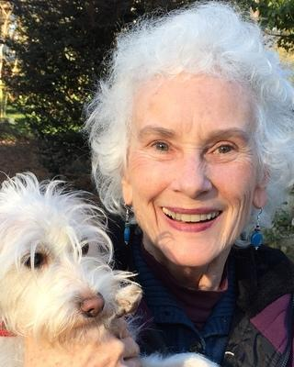
It all began in 1978
with two psychologists
Dr Pauline Rose Clance
Dr Suzanne Imes

Slide 11
At first, they thought it only touched women…
The imposter phenomenon in high achieving women: dynamics and therapeutic intervention
But since then, more research has been conducted
Pauline Rose Clance & Suzanne Imes

Slide 12
It turns out…

Slide 13
The feeling is spread equally among men and women

Slide 14
Nowadays, we estimate that
70%
of all humankind experiences this feeling

Slide 15
It’s not a disease, it’s a common human experience!
This is why Dr Clance herself now uses the term ‘impostor phenomenon’ (and so should we)

Slide 16
Isn’t it more widespread in tech though?
I mean…
Yeah, some factors don’t help ➡️
The field of competence is very wide
⬇️
It’s impossible to master everything
⬇️
The tech and tools are evolving fast
⬇️
We’re constantly becoming ‘juniors’ again

Slide 17
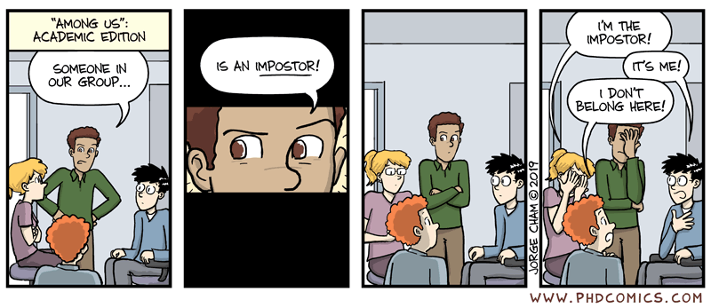

Slide 18
3. Ok but… What is it?
//
Oh you wanted an actual definition?

Slide 19
atychiphobia
It’s kinda like
Notes:
\a.ti.ki.fɔ.bia\

Slide 20
atychiphobia
It’s kinda like

Slide 21
kakorraphiophobia
It’s kinda like
Notes:
Kakora fayo fobia https://www.youtube.com/watch?v=Zi7qDP17I64

Slide 22
The fear of failure
Ok fine listen, it’s like

Slide 23
OK, we need Wikipedia
“
Impostor syndrome [...] is a psychological occurrence in which an individual doubts their skills, talents, or accomplishments and has a persistent internalized fear of being exposed as a fraud.
Despite external evidence of their competence, those experiencing this phenomenon do not believe they deserve their success or luck.
[...] they may think that they are deceiving others because they feel as if they are not as intelligent as they outwardly portray themselves to be.
”

Slide 24
Have you ever heard of the fundamental attribution error?
It’s the tendency for people to under-emphasize situational and environmental explanations [...] while overemphasizing dispositional- and personality-based explanations.
(Thank you Wikipedia, again)

Slide 25

Screenshot:
“L'effet Julien Lepers”, Horizon Gull

Slide 26
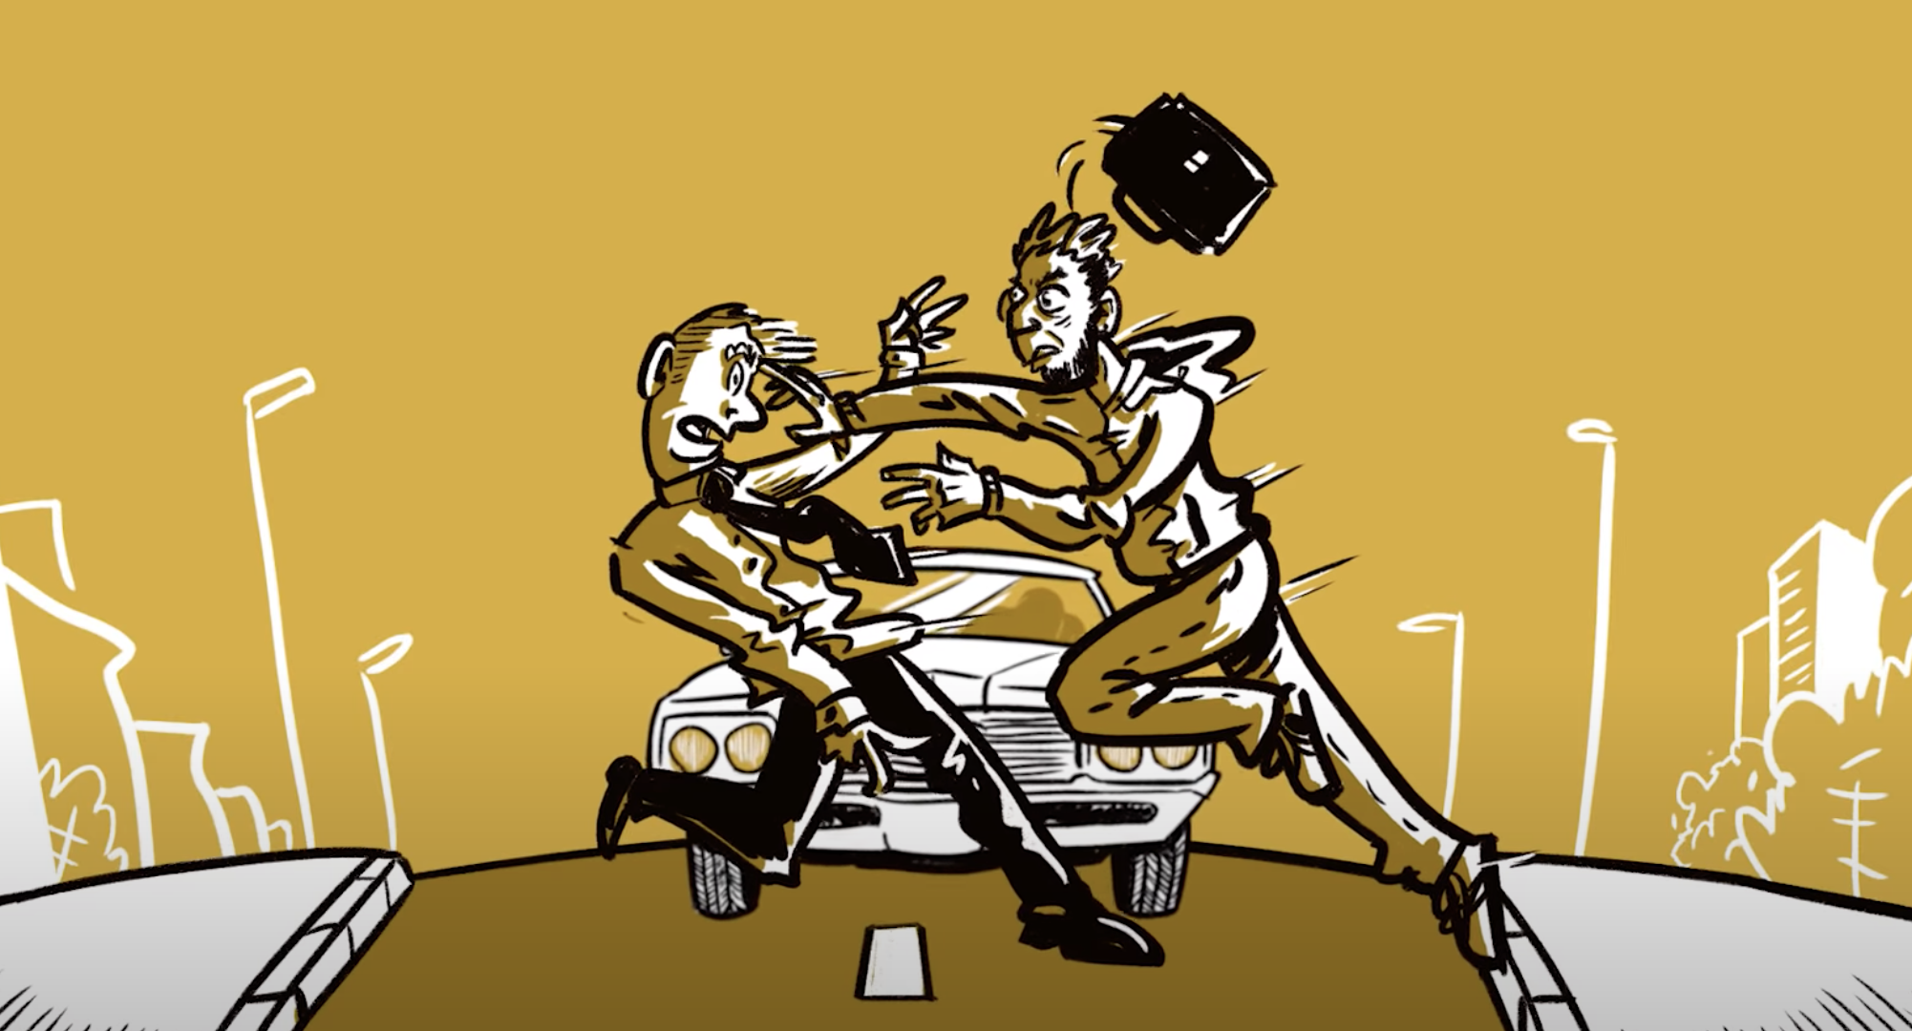
Screenshot:
“L'effet Julien Lepers”, Horizon Gull

Slide 27
So the impostor phenomenon is pretty much the opposite!
Because you
overestimate external explanations
(aka: you’re just lucky)
while you underestimate internal explanations
(aka: you’re actually doing fine!)

Slide 28
Careful though!
Not everything is ‘impostor syndrome’!

Slide 29
There’s a difference between the impostor phenomenon and…

Slide 30
a bad work environment
Notes:
A new mission / new responsibilities without training or resources:
Pressure, management denigrating you;
Coercion, demanding more and more work from you;
Harassment, toxic work environment;
=> the problem is not YOU and it’s not in your head!

Slide 31
It’s normal
Underrepresented groups
Fancy new tech you don’t understand (yet)
Colleagues with 20+ years of experience
Switching careers
First job after school
Starting over at a new company
to have doubts sometimes!
Notes:
Remember what I said earlier about my own experience? There it is. I’m a woman in a men-dominated field. When I started working on this, more than a year ago, I was working with very technical people and that was HARD.

Slide 32


Slide 33
Oh no
Here comes the part where you have to contribute

Slide 34

Notes:
If you’ve felt like an impostor clap your hands
If you’ve felt like an impostor clap your hands
If you’ve felt like an impostor
But somehow you’re still there
If you’ve felt like an impostor clap your hands
If you want to hear the next part, clap your hands! OK then moving on!

Slide 35
4. The practical bit, finally
//
Oh you wanted an actual definition?

Slide 36

Is it me, or is it the context around me?
Do I know what is expected of me?
Is communication fluid?
Is my job description clear?
Are my goals realistic and explicit?
Is the feeling recurrent?
Am I sensitive to a specific context (a new project, a new stack, a subject I don’t feel comfortable with?)
Is the feeling linked to someone in particular?
Do I get regular feedback?
Is the feedback always negative?
Do I always feel like I don’t deserve the praise I get, or do I enjoy some of my achievements?

Slide 37

Getting past comparison & competition
The Internet stars are not the only talented people!
Lots of anonymous devs are experts in their fields
By the way, being famous is not a proof of expertise…
There’s a reason we work in teams.
The differences in profile, experience and seniority enrich the team. Diversity is the key!
Accept that the others don’t know everything either

Slide 38
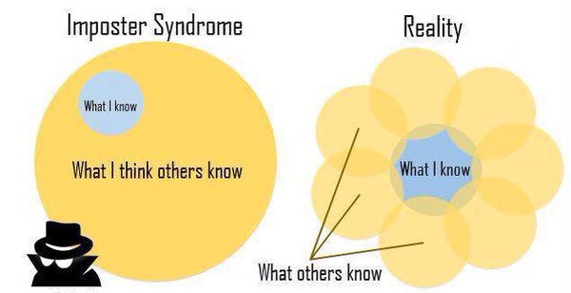
Getting past comparison & competition

Slide 39
Getting past comparison & competition
The Internet stars are not the only talented people!
Lots of anonymous devs are experts in their fields
By the way, being famous is not a proof of expertise…
There’s a reason we work in teams.
The differences in profile, experience and seniority enrich the team. Diversity is the key!
Accept that the others don’t know everything either
Take an interest in other people’s journey
How did they get here, what challenges did they overcome, what did they study, what was hard for them…
Get inspired! That might kickstart your own growth.

Slide 40

Working on your (perceived) weaknesses
Target
What is a cause of stress every single time?
What do I have to do often?
What is expected of me?
Prioritize
Choose one topic at a time and delve in it
Wandering means you will stay on the surface
Being recognized in your speciality is fulfilling!
Split!
Transform that mountain in small, manageable steps
Track your progress :)

Slide 41

Work on different skills
The aim: seeing your own progress
Go for dev-adjacent skills
Agility, communication, a new (human) language, web quality, accessibility, DevOps…
Bonus: it adds to your resume!
Or… go for something else entirely!
Pottery, gardening, knitting… doing something tangible for a change feels good
It’s a way to clear your mind, stop thinking about work
It’s not stressful: you’re doing something for yourself, there’s nothing at stake

Slide 42

Don’t stay alone
Tell your team you need them!
Ask for regular feedback
Get help in order to reach your goals
Find your community
For me, it’s Duchess France, a women in tech network
Because it’s sometimes easier to be vulnerable with people outside your work team
Because you need people who have had similar experiences
Knowing that others enjoy working with you is the boost you need to see that you do belong!

Slide 43

Sharing is caring
Help others grow!
Support juniors / interns / new members
Offer pair programming sessions
Share the articles you read
Explain your job in schools, inspire new generations
Become a speaker, write articles
Choose a subject and deep-dive or present it with a different angle
You know you master your subject when you can explain it to others :)

Slide 44

Knowing that it has a name :)
YES you are normal!
You can ignore it and live with it, too.

Slide 45

Getting (professional) help
Coaching, mentoring
Private classes, trainings, certifications
Mental health care

Slide 46
5. “Not a question, more of a comment”
//
We don’t have time for questions anyway.

Slide 47
Marine Gandy (aka Mupsi)
DevRel Engineer, Platform.sh
marine.gandy@platform.sh
Mupsi.dev
Twitter
Linkedin

Slide 48
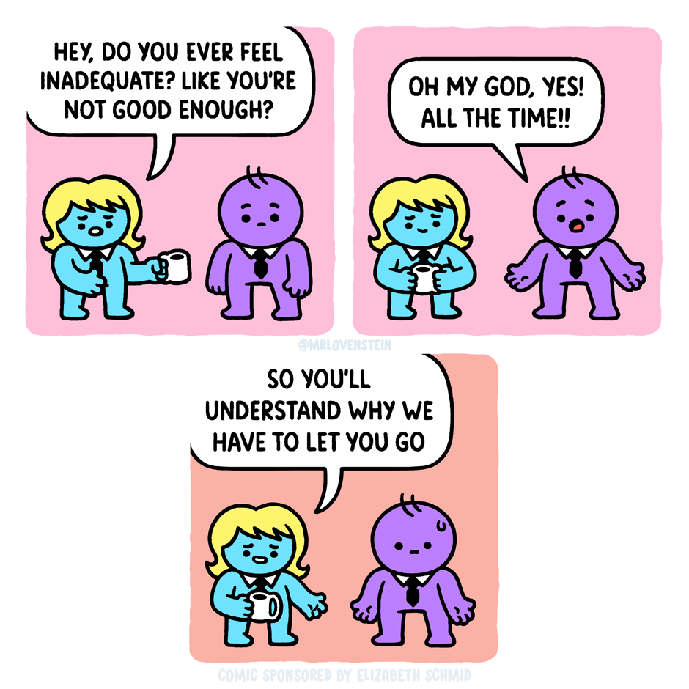
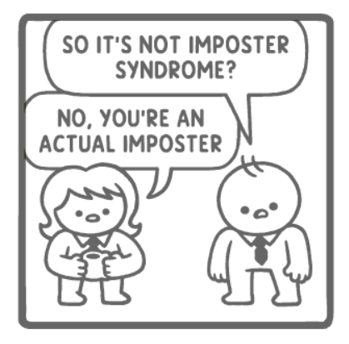
‘Assurance Fraud’ by Mr. Lovenstein
Notes:
https://tapas.io/episode/2640963

Slide 49
6. Sources???
//
I promise I didn’t make it up!

Slide 50
The origins
Wikipedia article on impostor syndrome https://en.wikipedia.org/wiki/Impostor_syndrome
Compilation of research on the impostor phenomenon, Dr Pauline Rose Clance https://www.paulineroseclance.com/impostor_phenomenon.html
Clance Impostor Phenomenon Scale https://www.paulineroseclance.com/pdf/IPTestandscoring.pdf
‘The Imposter Phenomenon in High Achieving Women: Dynamics and Therapeutic Intervention’, Pauline Rose Clance & Suzanne Imes https://www.paulineroseclance.com/pdf/ip_high_achieving_women.pdf

Slide 51
Articles
‘Why Learning to Code is So Damn Hard’ https://www.thinkful.com/blog/why-learning-to-code-is-so-damn-hard/
‘Stop Telling Women They Have Imposter Syndrome’ https://hbr.org/2021/02/stop-telling-women-they-have-imposter-syndrome
‘The Dangers of Feeling Like a Fake’ https://hbr.org/2005/09/the-dangers-of-feeling-like-a-fake
‘Feel like a fraud?’ https://www.apa.org/gradpsych/2013/11/fraud
‘Feeling Like a Fraud: The Impostor Phenomenon in Science Writing’ https://www.theopennotebook.com/2016/11/15/feeling-like-a-fraud-the-impostor-phenomenon-in-science-writing/
‘It's not fucking imposter syndrome, you just worked with assholes.’ https://dearfuckers.substack.com/p/its-not-fucking-imposter-syndrome

Slide 52
Videos
‘What is imposter syndrome and how can you combat it?’, Elizabeth Cox https://www.youtube.com/watch?v=ZQUxL4Jm1Lo
‘How you can use impostor syndrome to your benefit’, Mike Cannon-Brookes (Atlassian) https://youtu.be/ZkwqZfvbdFw
‘6 Signs You Might Have Impostor Syndrome’, Psych2Go https://www.youtube.com/watch?v=xvGawC0eS4w
“L'effet Julien Lepers”, Horizon Gull (FR) https://www.youtube.com/watch?v=mrXtwcGkroI
“Pourquoi les américains nous paraissent-ils idiots ?”, Horizon Gull (FR) https://www.youtube.com/watch?v=Ic3xHn1E8EE

Slide 53
Random
‘“Among Us”: Academic edition’ by PhD Comics https://phdcomics.com/comics/archive.php?comicid=2042
‘Assurance Fraud’ by Mr. Lovenstein https://tapas.io/episode/2640963
Fundamental attribution error https://en.wikipedia.org/wiki/Fundamental_attribution_error
‘Batman: The Imposter’ trailer https://www.youtube.com/watch?v=O9L_70vpquQ
Dave Gahan’s ‘Imposter’ album https://www.youtube.com/playlist?list=PLK8pmrLAfsrgtiJxu9NmIXg-Jndm4iDvA

